Slide 1

Preprocessed Data
Completed Work

Slide 2
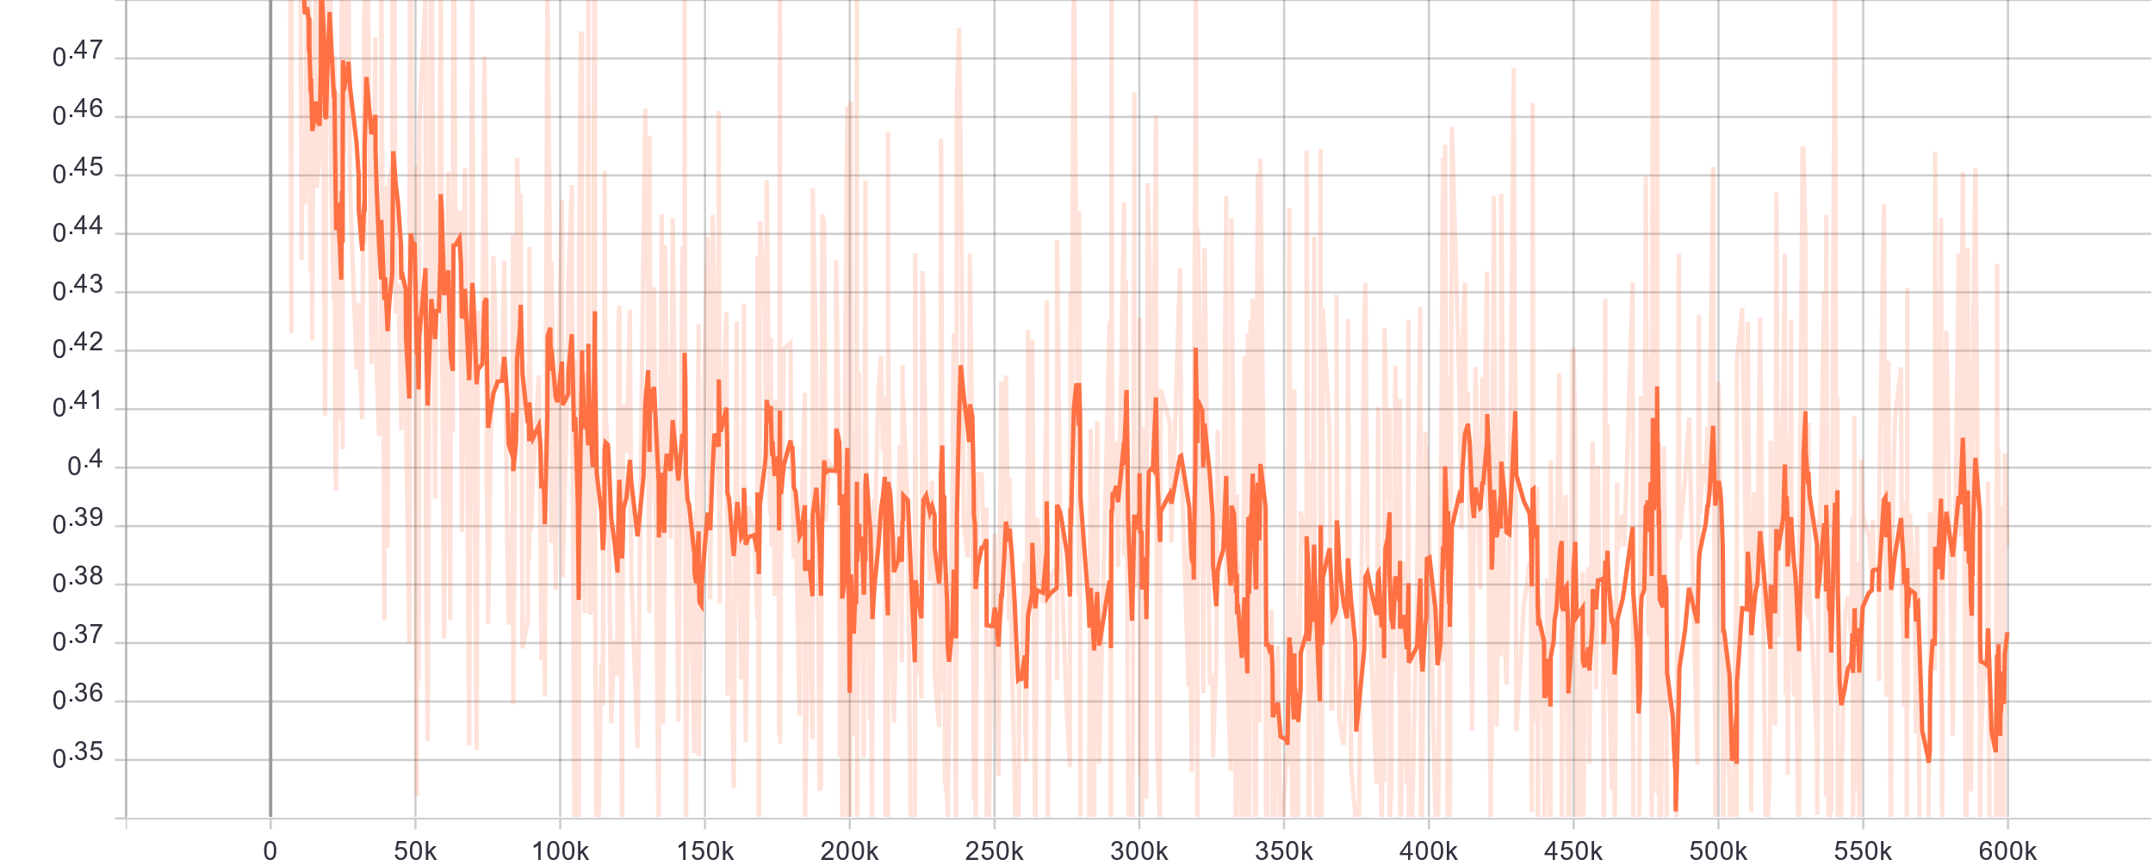
Total loss vs. iteration(600k iteration / 3k epoch)
Completed Work

Slide 3
1. Try to train some other network architectures as the baseline 2. Visualize the feature of different layers
Next weeks:

